Slide 1


Introduction to Bash Shell Scripting
Fondren Library
Digital Scholarship Services

Slide 2
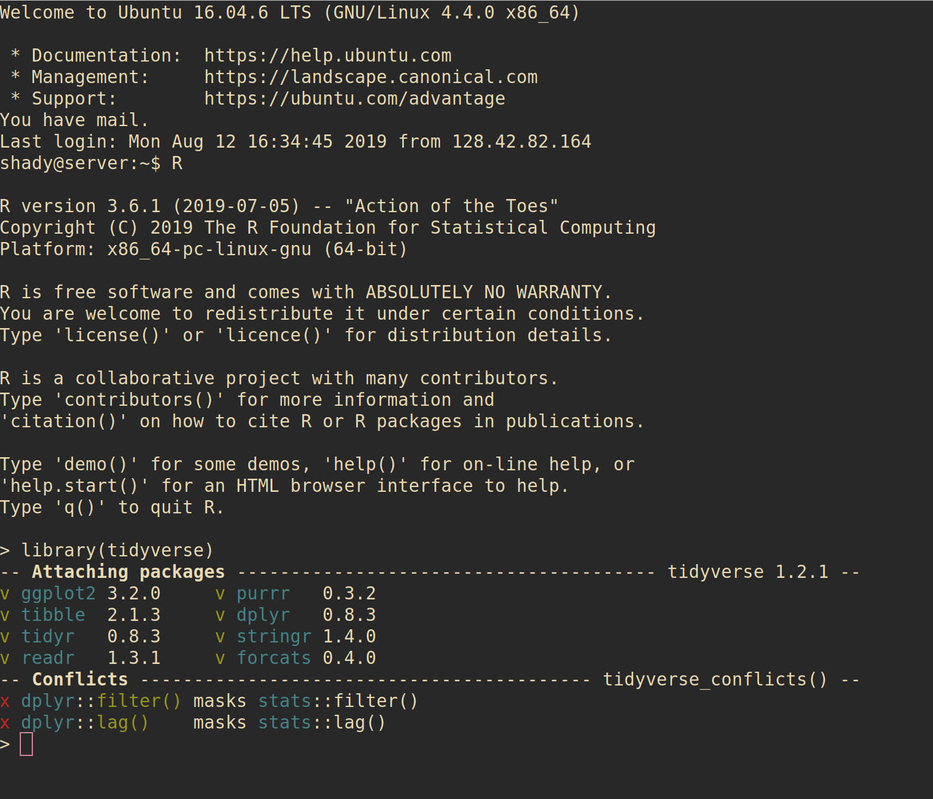
WHAT IS A SHELL?
Very simple and direct interface to an operating system
Allows easy execution of programs and file operations
Highly configurable without needing to sort through massive menus
Fast and lightweight

Slide 3
WHAT IS BASH?
Bourne-Again Shell
Play on words: Stephen Bourne wrote the initial Unix shell
Improved on Bourne shell (sh)
More features, better builtins
Completely free and open-source for all platforms, licensed under the GNU public license

Slide 4
HOW DO I GET BASH?
On Unix-based platforms (Mac OS, Linux, etc) it will almost always be installed by default
Windows (the only major non-Unix-based OS):
Enable Windows subsystem for Linux
Install Ubuntu for Windows
or
Install minGW (minimalist GNU for Windows)
Make sure to select the msys developer kit!

Slide 5
WHEN DO I USE BASH?
Versus Scripting Languages (e.g. Perl, Python, Ruby, Lua)
If you’re going to be running this script on your local computer only
Bash allows simpler access to commands with extensive shell-specific or installation-specific features, often unsupported by scripting languages
Say you have your Microsoft Office installed to an external hard drive, and not the customary C:/ location. You can’t expect everyone on other computers to do this as well!
Scripting languages are usually easier to program in but don’t interface seamlessly with the OS
This is mostly because they strive to work on multiple OSes, so they need an additional level of abstraction

Slide 6
WHEN DO I USE BASH?
Versus a Visual Environment
Often with remote servers, you have to use a terminal
Visual environments are great for quickly looking through file structures
Shell environments are great if you want to run any slightly advanced query (find operations, etc) and for programming
My suggestion: use them together!
Navigate and change directories visually
Drag and drop directories and files into your shell if you need to do other things

Slide 7
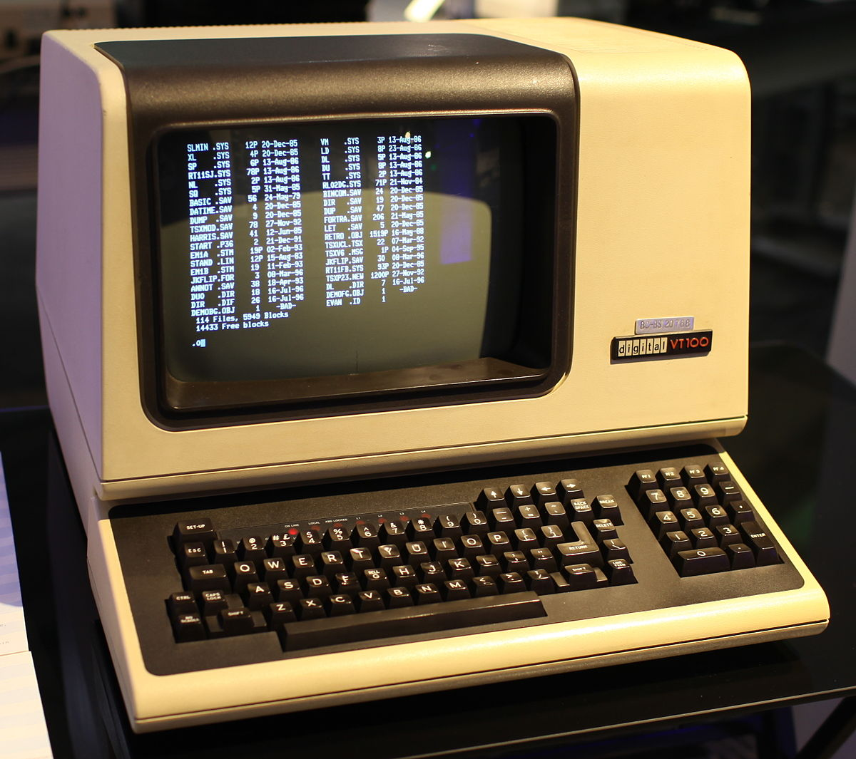
A LITTLE HISTORY
Before the advent of Microsoft Windows (1981) and Mac OS (1984) and their desktop environments, terminals were the only option!
Unix was the most used, developed by Bell Labs at AT&T
Unix adapted by Linus Torvalds into Linux, and enjoyed Free Software Movement support

Slide 8
A WORD ON UNIX’S PHILOSOPHY
First two points of the Unix Philosophy:
Make each program do one thing well. To do a new job, build afresh rather than complicate old programs by adding new “features.”
Expect the output of every program to become the input to another, as yet unknown, program. Don’t clutter output with extraneous information. Avoid stringently columnar or binary input formats. Don’t insist on interactive input.
These two points are what makes shell scripting in Unix-derived environments so powerful!

Slide 9
SHELL BASICS
A quick walkthrough of the environment

Slide 10
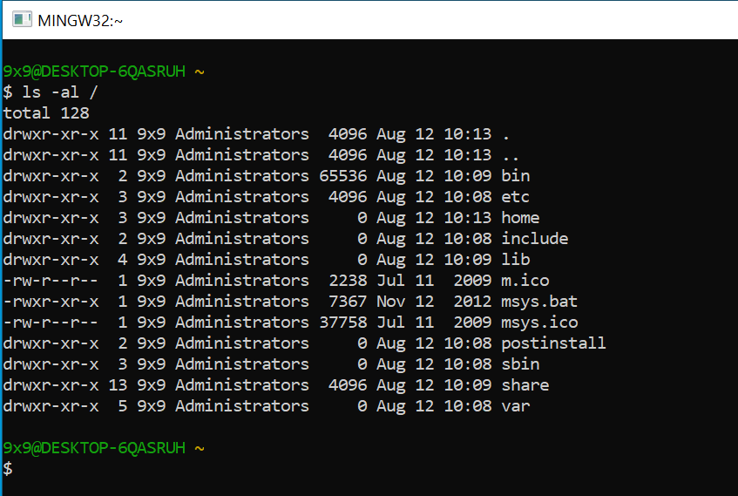
ANATOMY OF A SHELL
Prompt: what you see when you open the shell or finish a command
Waits for you to enter something
USER@COMPUTER (Directory)
$ (type commands here)
completely configurable, though
Command
Output

Slide 11
COMMANDS
First: an executable program (or shell builtin)
Anything from word.exe to simply listing the directory
Any number of arguments
Filenames, command line switches
example: ls –al Documents/
ls is a program that lists the current directory
-al are two separate arguments that show hidden files and permissions
Documents/ is a folder in the current directory we want the get the contents of
Use --help and/or man command!

Slide 12
ENVIRONMENT
Several environment variables
PWD (print working directory)
PATH (where to look for executable files – usually not your current directory!)
Many more (if you’re curious, type in env!)
This is how we can keep track of our state
Note that on Windows (more accurately NTFS/FAT file systems) case does not matter (File.txt is the same as filE.tXt), but on Linux (ext4) case matters

Slide 13
FILES
Special file shortcuts in bash
. -> This directory
.. -> Parent directory
~ -> User’s home directory
/ -> System root
Just type a few characters of the file then press tab to autocomplete!
Permissions: read, write, and execute
Any file can be executed!

Slide 14
REFERRING TO FILES
Make sure to quote your files with spaces in them!
If you have a file called my file.docx, you need to type “my file.docx” to refer to it in a shell environment

Slide 15
CONFIGURATION
Making your shell look and act its best!

Slide 16
SPECIAL FILES
.bashrc
Run every time you start bash
Great for configuring global settings and define useful things
.bash_profile
Run even when you don’t run bash interactively
Useful for scripts and startup commands!
.bash_history
Re-run previous commands with arrow keys up/down
HUGE time saver if you mistype commands

Slide 17
COLORS AND FONTS
Technically, a feature of your terminal emulator, not the terminal itself
Terminal emulator is basically just the window running the shell and allowing input
Modern shells have support for colors
Great for distinguishing between file types (directory versus program versus document)
Check out https://misc.flogisoft.com/bash/tip_colors_and_formatting/ for instructions!

Slide 18
PROMPTS
Configure the colors and information displayed on your prompt
If you want to customize what information shows in your prompt, open up your ~/.bashrc file and change things
Remember to enclose formatting characters in \[ \]!

Slide 19
USEFUL PROGRAMS
Getting to know our tools

Slide 20
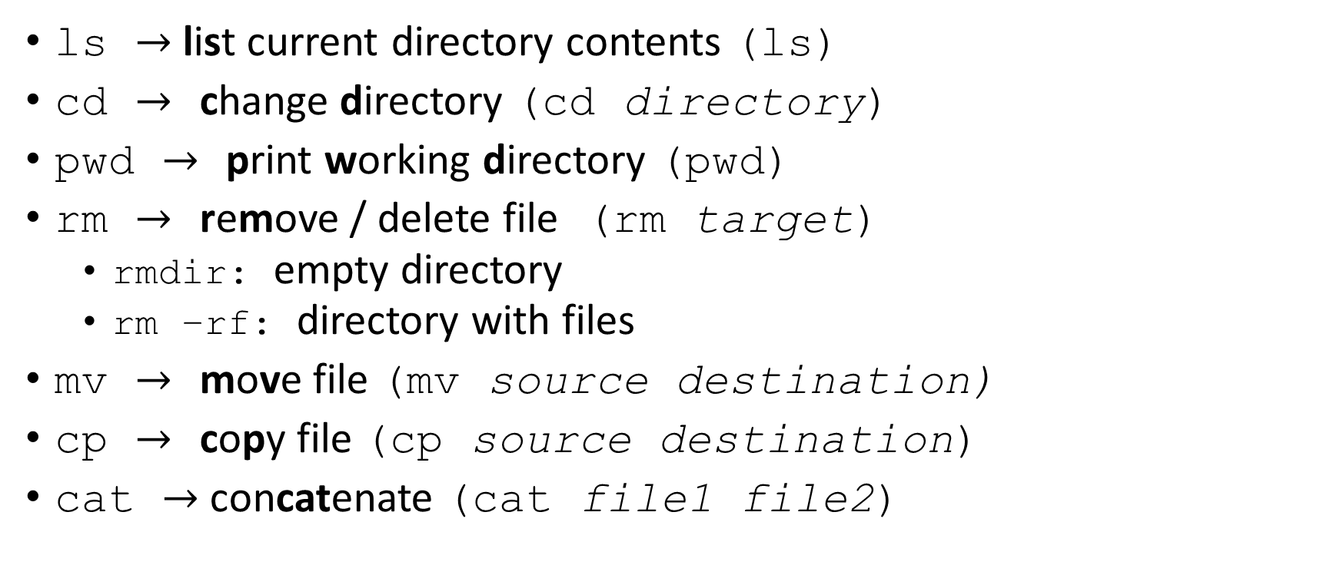
FILES AND DIRECTORIES
ls $→$list current directory contents (ls)
cd $→$ change directory (cd directory)
pwd $→$ print working directory (pwd)
rm $→$ remove / delete file (rm target)
rmdir: empty directory
rm –rf: directory with files
mv $→$ move file (mv source destination)
cp $→$ copy file (cp source destination)
cat $→$ concatenate (cat file1 file2)

Slide 21
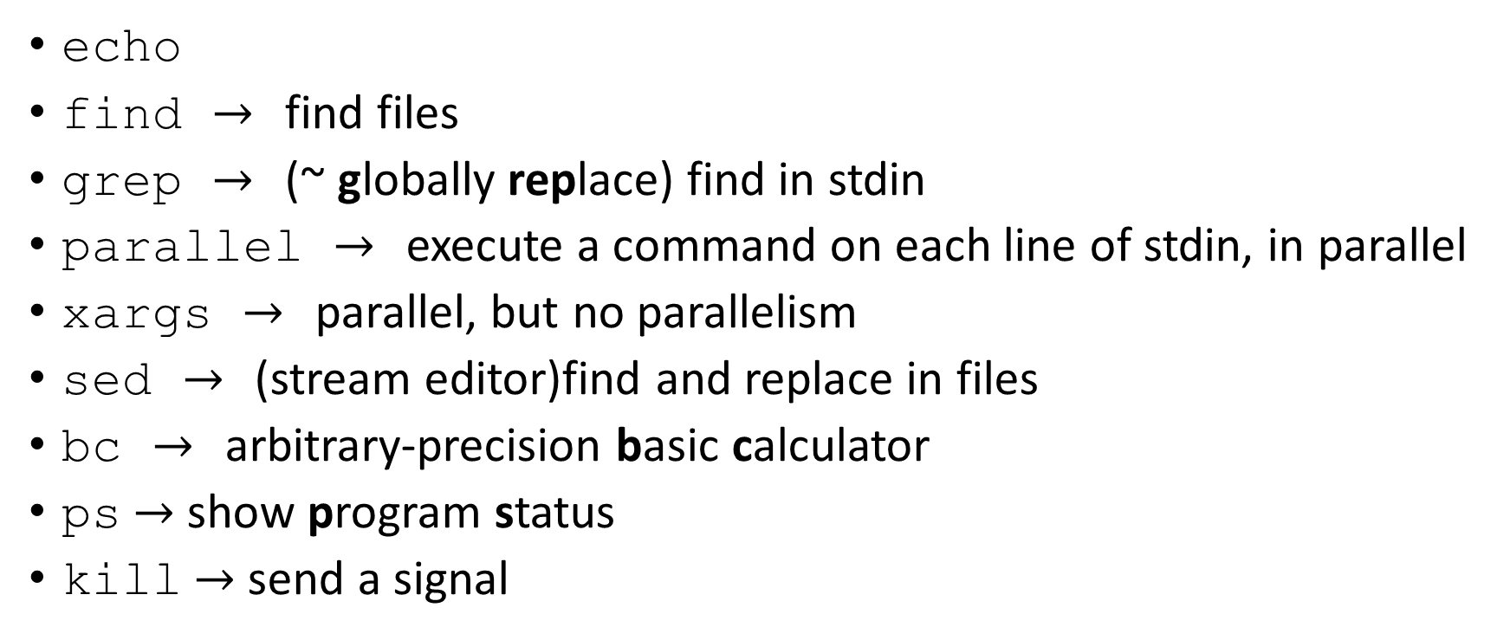
OPERATIONS
echo
find $→$ find files
grep $→$ (~ globally replace) find in stdin
parallel $→$ execute a command on each line of stdin, in parallel
xargs $→$ parallel, but no parallelism
sed $→$ (stream editor)find and replace in files
bc $→$ arbitrary-precision basic calculator
ps $→$ show program status
kill $→$ send a signal

Slide 22
GLOBBING
A way to match files effectively
Less powerful than regular expressions, but much simpler and quicker
Essentially, just use * to match any number of any kind of characters
*.txt will find all text files, for instance
But what if you want to match only files that start with numbers?
You’ll need regular expressions!

Slide 23
REGULAR EXPRESSIONS
The gold standard for text matching
Extraordinarily useful, but notoriously tough and error-prone
Never match by regular expression if you don’t have to!
If you can glob, glob!
A bit like globbing but with a ton of additional features
Great resource: regexr.com

Slide 24
REGULAR EXPRESSION SYNTAX
. matches any one character
“cat! ” matches ….
* matches previous character 0 or more times
“maaaaaan” matches ma*ne*
+ matches previous character 1 or more times
“maaaaaan” matches ma+n but not ma+ne+
? matches previous character 0 or 1 times
“cat” and “cats” match cats?
{m, n} matches previous character between m and n times
“maaaaaan” matches ma{2,8}n but not ma{1,5}n
^ means start of line, $ means end of line
“cation” but not “Acatia” matches ^cat, “friend” but not “endoscopic” matches end$

Slide 25
REGULAR EXPRESSION SYNTAX 2
[characters] will match any character in the brackets
“cut”, “cat”, “cot” match c[aou]t
If first is ^, matches everything but them ([^a] matches everything but a)
Can use ranges such as a-z, A-Z, 0-9
[:punct:] (punctuation)
\s matches a space, \d a digit, \w alphanumeric, \b beginning of word
Capital inverts the meaning. \D means everything but a digit
Matching special characters requires using \ (escaping)
“what cat?” matches cat\?$ but not cat?$
Forgetting to escape special characters can cause very annoying and hard to find bugs

Slide 26
GREP
Search for strings in files or in program output
I always recommend quoting your regular expressions!
grep “\bF” countries.txt would find all countries starting with the letter F
\b means word boundary

Slide 27
SED
Replacing strings within files
Options I like:
-i means modify the file in-place instead of making a new one.
-r means use regex. If you don’t use this, the replacement will be literal.
replace syntax examples:
sed -i “s/doller/dollar/g” file.txt
s for search, g for globally replace
sed –ir “s/Season([0-9]+) Episode ([0-9]+)/S\1E\2/g” seasons.txt
If you want to replace with strings depending on what you match, use \1, \2, etc. Make sure you enclose the important parts of the pattern with parentheses!

Slide 28
FIND
General syntax: find (starting directory) (expression)
Often use starting directory as . (current directory)
Common expression types:
-name fragment, with globbing
-mmin / -mtime time in minutes / hours
-size size (G, M, k, etc)
-type (d for directory, f for file, l for link)
Can combine them as well
Sizes and minutes can be specified as exact, less than or greater than (-/+)
-mmin -3 means modified more than 3 minutes ago

Slide 29
INPUT AND OUTPUT
3 separate input/output streams
Standard Output (stdout)
Standard Input (stdin)
Standard Error (stderr)
Redirection
Input: < file
Standard Output: > file
Standard Error: 2> file
Standard Output and Error: &> file
Append with >> (>> file)

Slide 30
PIPES
| character
Sends forms of output to a different program
By default, only stdout
Can pipe stderr with |&
Useful to avoid intermediate storing of data in temporary files
To sequentially pattern replace:
Say we have a bunch of items in a list, but we don’t want to manually number them because we think they may change, so we just use # as a placeholder
sed “s/\b#\b/1st/” <file.txt | sed “s/\b#\b/2nd/” | …

Slide 31
PARALLEL & XARGS

Slide 32
A CASE STUDY
Say our legal team wrote five thousand documents in our Documents folder in the last three hours to our business client Gerald to help him trademark a whole lot of company logos, but we realize we accidentally called him Greg in these documents. We don’t want to mess with any older files, because we have another client who is actually named Greg and we don’t want to mess those up. How can we fix this?
find Documents/ -type f -mtime -1 | xargs sed –i ‘s/Greg/Gerald/g’
or parallel, if you have it!
Try doing that with no shell!

Slide 33
SIGNALS
Shown as ^D in shell
Ctrl+D
End of input
Ctrl+C
Exit
Ctrl+Z
Pause running program
Restart with fg or bg (foreground, background)
Program can respond to these in other ways. Use kill to send other signals

Slide 34
KILL

Slide 35
PS

Slide 36
SCHEDULING WITH CRON
Crontab: has information for scheduling
Use https://crontab.guru to help with syntax
Example:
30 4 * * MON rm –rf /tmp/* means delete all temporary files at 4:30 AM every Monday

Slide 37
ADVANCED FEATURES
Rounding out your bash programming skills

Slide 38
SPECIAL/USEFUL FILES
/dev/null
Basically just means ignore
2>/dev/null: ignore error output
/dev/urandom
Read from this to get random data
Good for cryptography!

Slide 39
VARIABLES
Can name pieces of information and refer to them later
Define with let
Ex: let a=3
Refer with $
echo $a
Delete with unset
Unset $a
Echo $a #can’t find it!

Slide 40
BC

Slide 41
IF STATEMENTS
Conditionals:

Slide 42
FOR LOOPS
Good for ranges of values (i.e. a-z, 0-9)
Or, for lists of values (“cat”, “dog”, “frog”)

Slide 43
WHILE LOOPS
Do something over and over, as long as the condition is still true

Slide 44
JOBS
Multiple processes can be running in the shell at the same time
Start a job in the background by ending the line with &
Switch it back to foreground with fg
Great for long running processes – I use this with visual text editors all the time!

Slide 45
ALIASES
Handy shortcuts for long commands with lots of arguments
Don’t want to have to remember which options you need? Just make an alias!
Example: alias tarx=“tar -xzf” for a general tar extractor without having to remember which options you need

Slide 46
BASH FUNCTIONS
Great for writing quick, reusable programs that don’t quite fit into alias form
Get arguments with $1, $2, etc
Combine cd and ls
can’t quite do this with an alias, since you need to pass an argument and not just do a simple replacement
cs() { cd $1; ls}

Slide 47
CONDITONALLY RUN PROGRAMS
program1 && program2
Only run program2 if program1 is successful
Good if you have dependencies between commands
program1 || program2
Only run program2 if program1 fails
Good if you want to try to fix it

Slide 48
INTERACTIVE INPUT
Makes things harder to combine, but certainly still has its uses!

Slide 49
ACKNOWLEDGMENTS
The Bash Logo is licensed for free use under the Copyleft license.
The bash screenshot on Slide 2 is R and Bash running under a Remmina connection.
The picture on Slide 6 is licensed under Creative Commons Attribution-ShareAlike 4.0 International, created by Gorthmog

